Slide 1
Explore Data Geographically
BY: TUSHAR GOEL
BDS BATCH
25 MAY

Slide 2
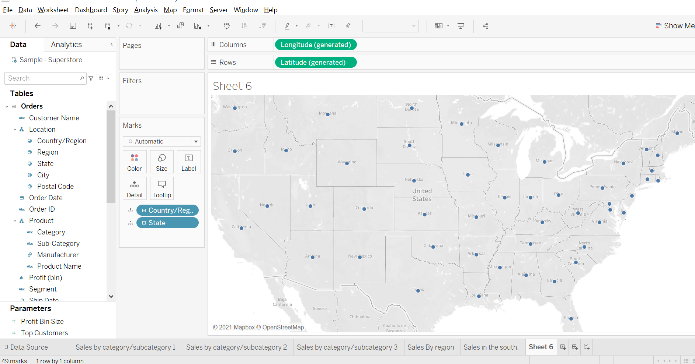
1. Create a Map view to represent all the states with country.

Slide 3
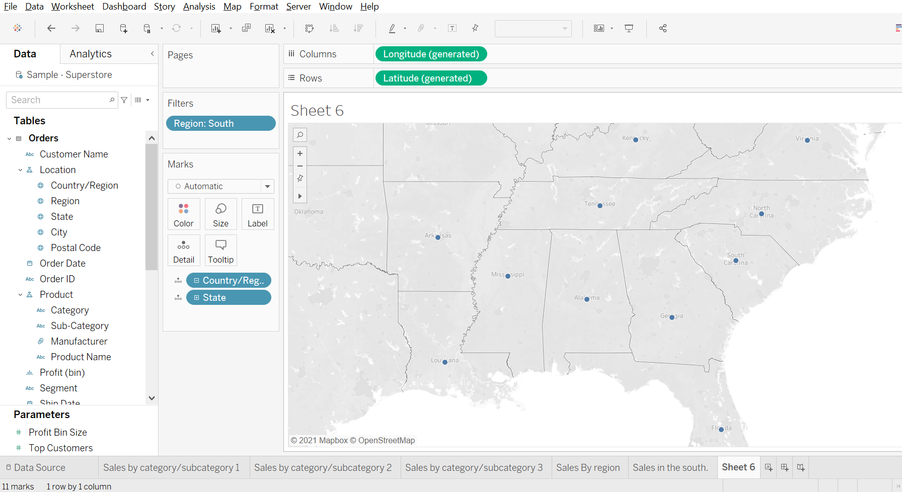
2. Check your map for south region.

Slide 4
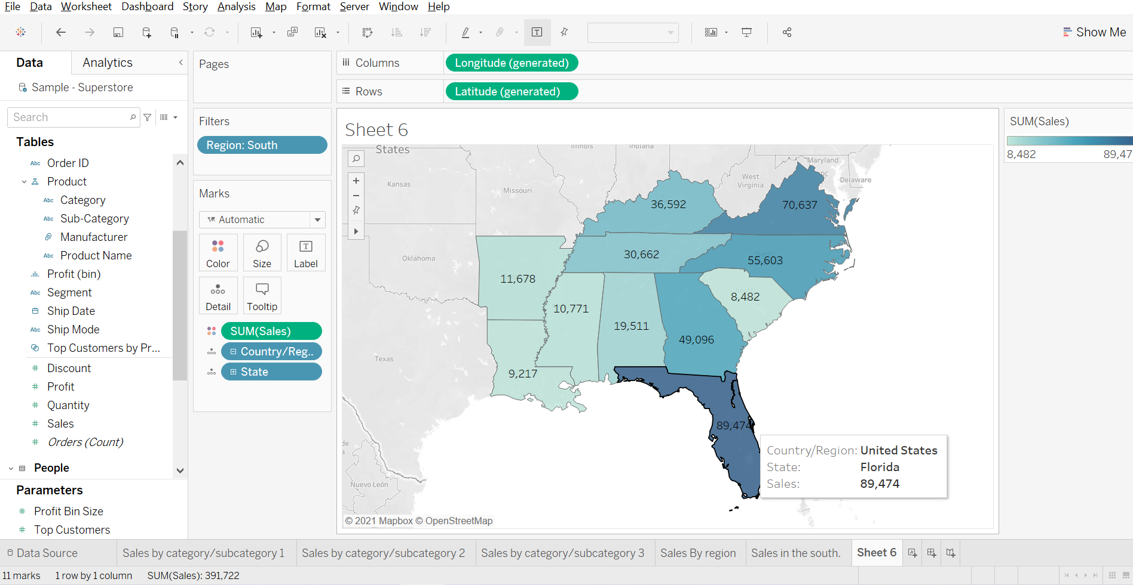
3. Check the sales for south region.

Slide 5
4. Find the state that has highest sales.
The Florida state has the highest Sales.

Slide 6
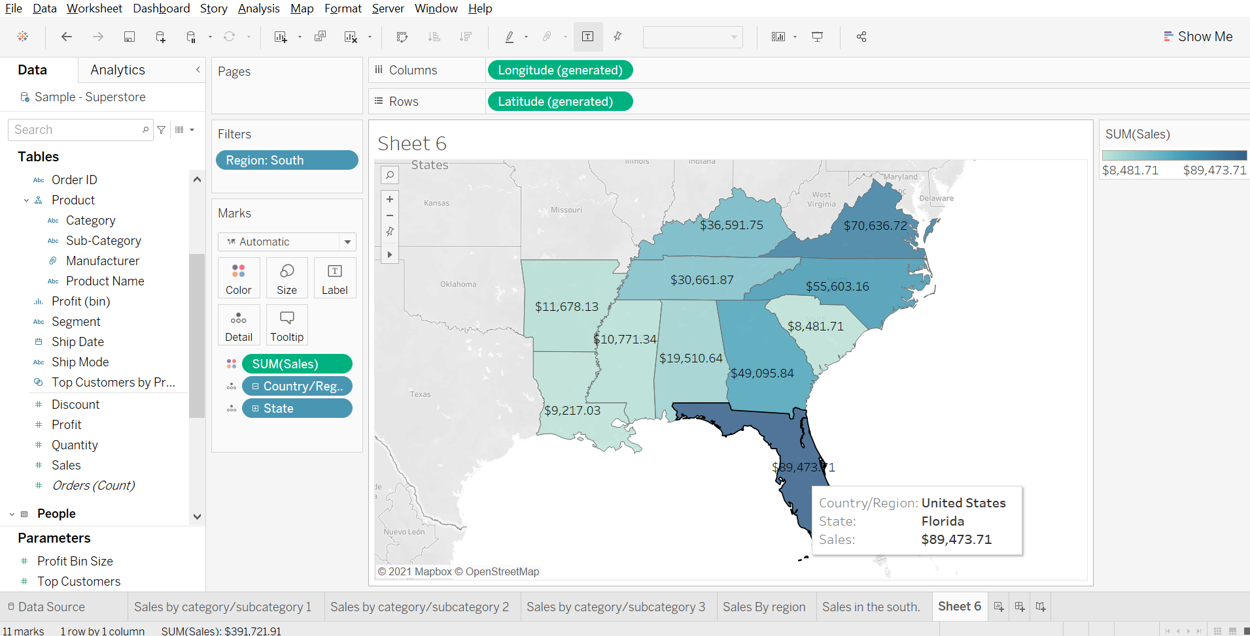
5. Represent your sales in USD.

Slide 7
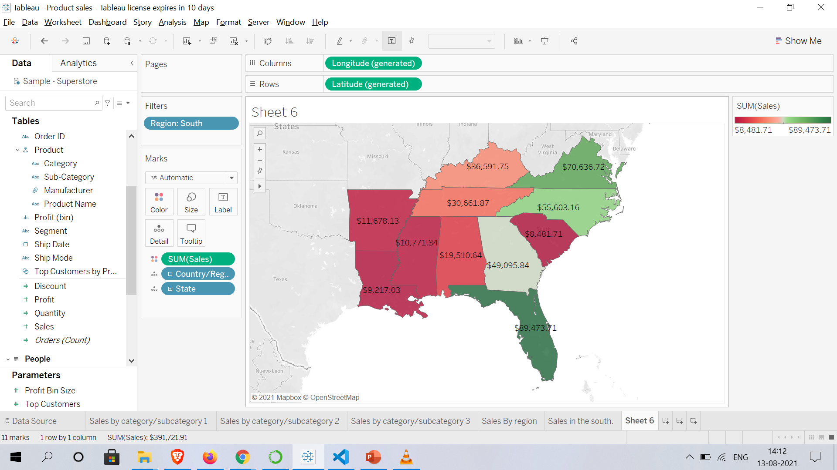
6. Edit color for you map.

Slide 8
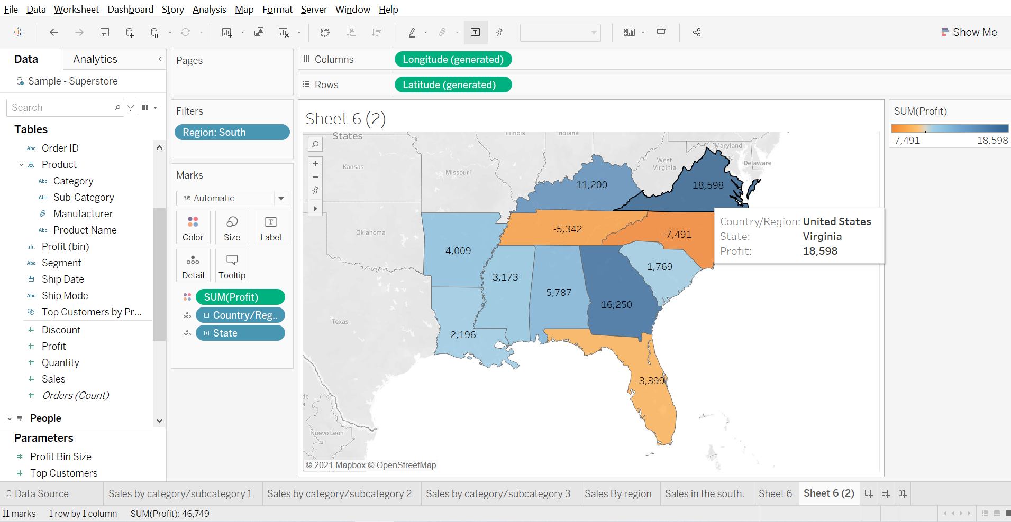
7. Show profit for all the states in your map in south region.

Slide 9
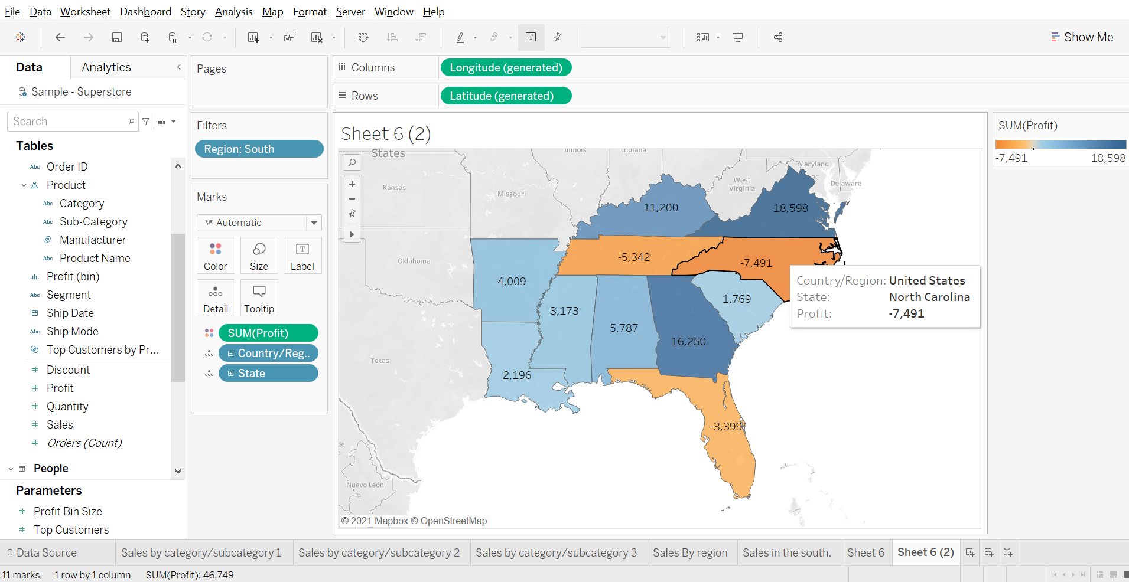
8. Find out the name of some states having negative profit.

Slide 10
10.Note down the name of the states having lowest profit and highest profit.
Lowest profit : North Carolina
Tennessee.
Florida.
Highest profit:

